Slide 1

Developing Farmer Enterprises (natural/organic)
“Farmer platform - of the farmer, by the farmer and for the farmer“
PADMANABH INNOVATIONS

Slide 2


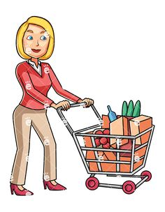
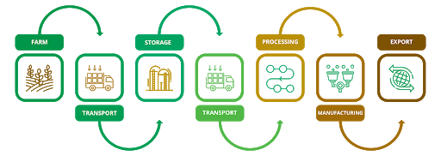


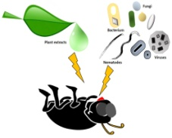
Natural/organic farmer not produce for commodity
Gaps between farmer and actual consumers
Maximum profit gains by channels
Consumer paid high prices and farmer earn less
Marketing and /value
addition challenges-
No farmer formal groups.
Small quantities of production high marketing and stock handling cost.
No awareness of supply chain and value addition.
Service base model not commodity model.
Too many Intermediates and no sale price
Natural farming issues (for farmers)
low productivity and certification process
Pest attack ,disease and Nutrient management.
Problem statement
Consumer side
Awareness about products importance.
Product are selling as premium products
limited products
Gap of transparency

Slide 3
Solutions: Developing farmer enterprises
Value addition | Demand | Brand | Technology
Sustainable model
Natural/organic productivity, marketing and creating a long sustainable profitable model so that farmer may attract for new invention and enterprising activities
01
Quality standards
02
Consumer farmer relationship
Farmer price
03
Develop profitability model for farmers
Value addition
04
Develop value addition services
Support system
Provide technical support for production and marketing.
www.free-powerpoint-templates-design.com

Slide 4

Product/Service
Developing Farmer Enterprises (natural/organic)
"of the farmer, by the farmer and for the farmer"
1st
2nd
Farmer cluster
Growing demand and market
Higher productivity, price, value addition, supply chain
Training, lab, technical support
Vegetable, Fruits, Cereals, oil seed, pulses, Masala
Retail/local, chain store, global buyer
Farmer own brand
Entrepreneurship-incentives
3rd
4th
Platform
Customer services
Consumer integration
knowledge platform
Backward integration
Application support
Direct Consumer with quality
Brand value – cost benefits
Mid level market – within the reach
Application support

Slide 5
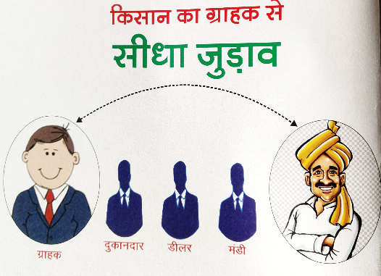
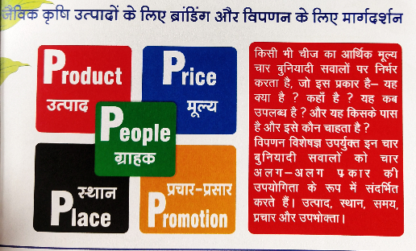





Product/Service
Customer support | E-learning | Publication | Technology support

Slide 6
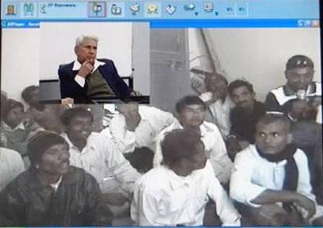
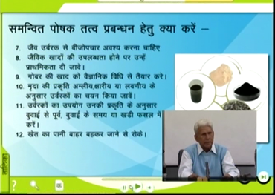
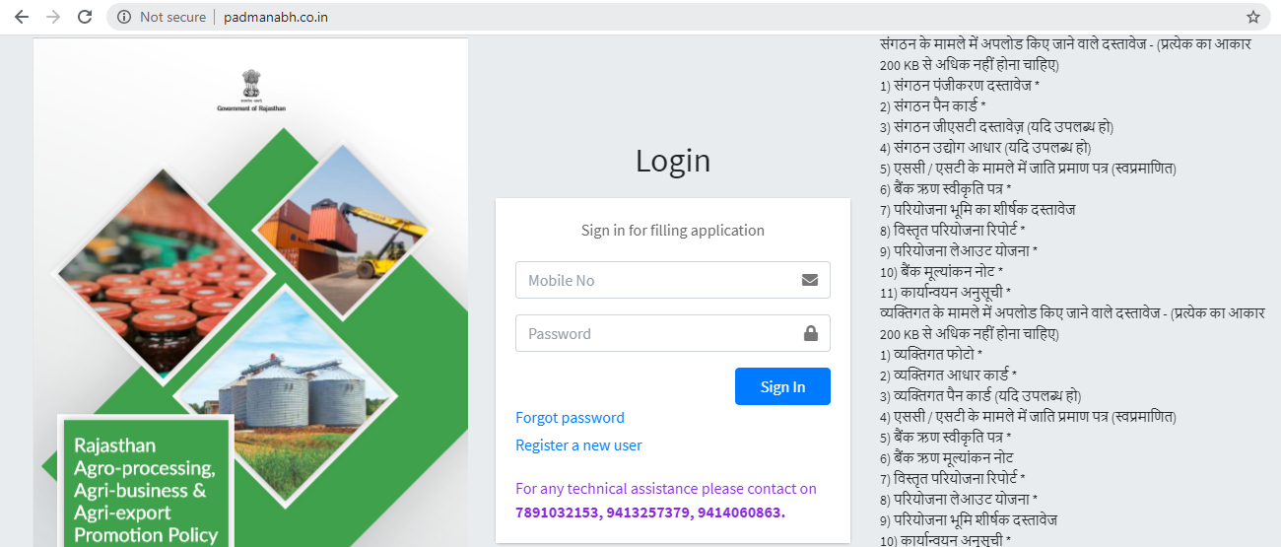
Product/Service

Slide 7
